Slide 1
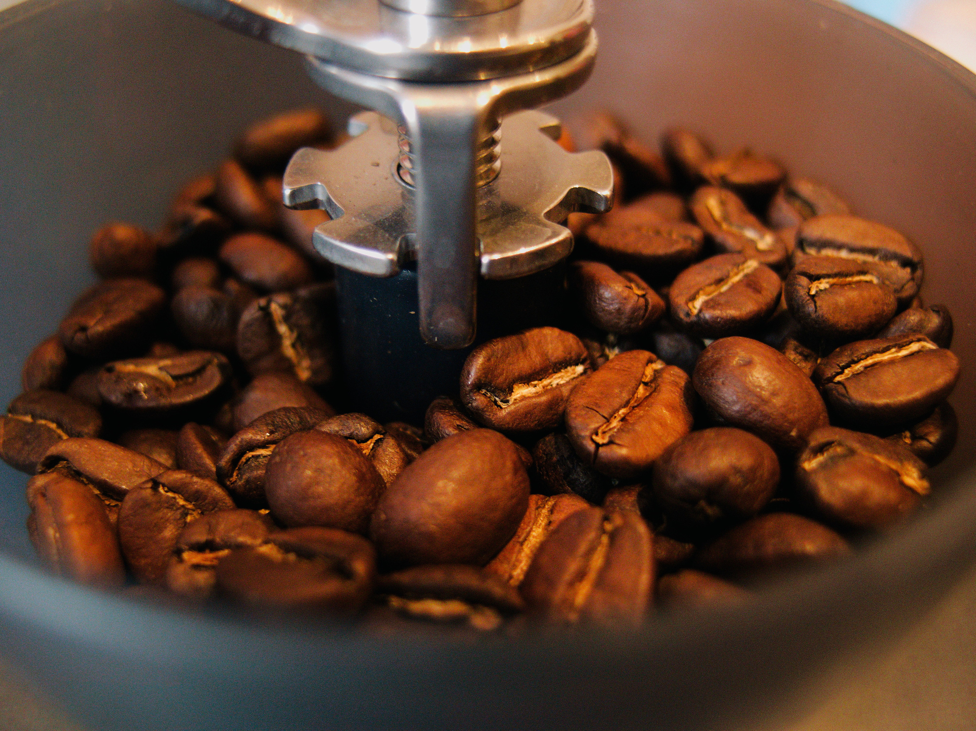



Cafe Management System
Presented by
Nadigepu Ashwitha
(120422539008)

Slide 2
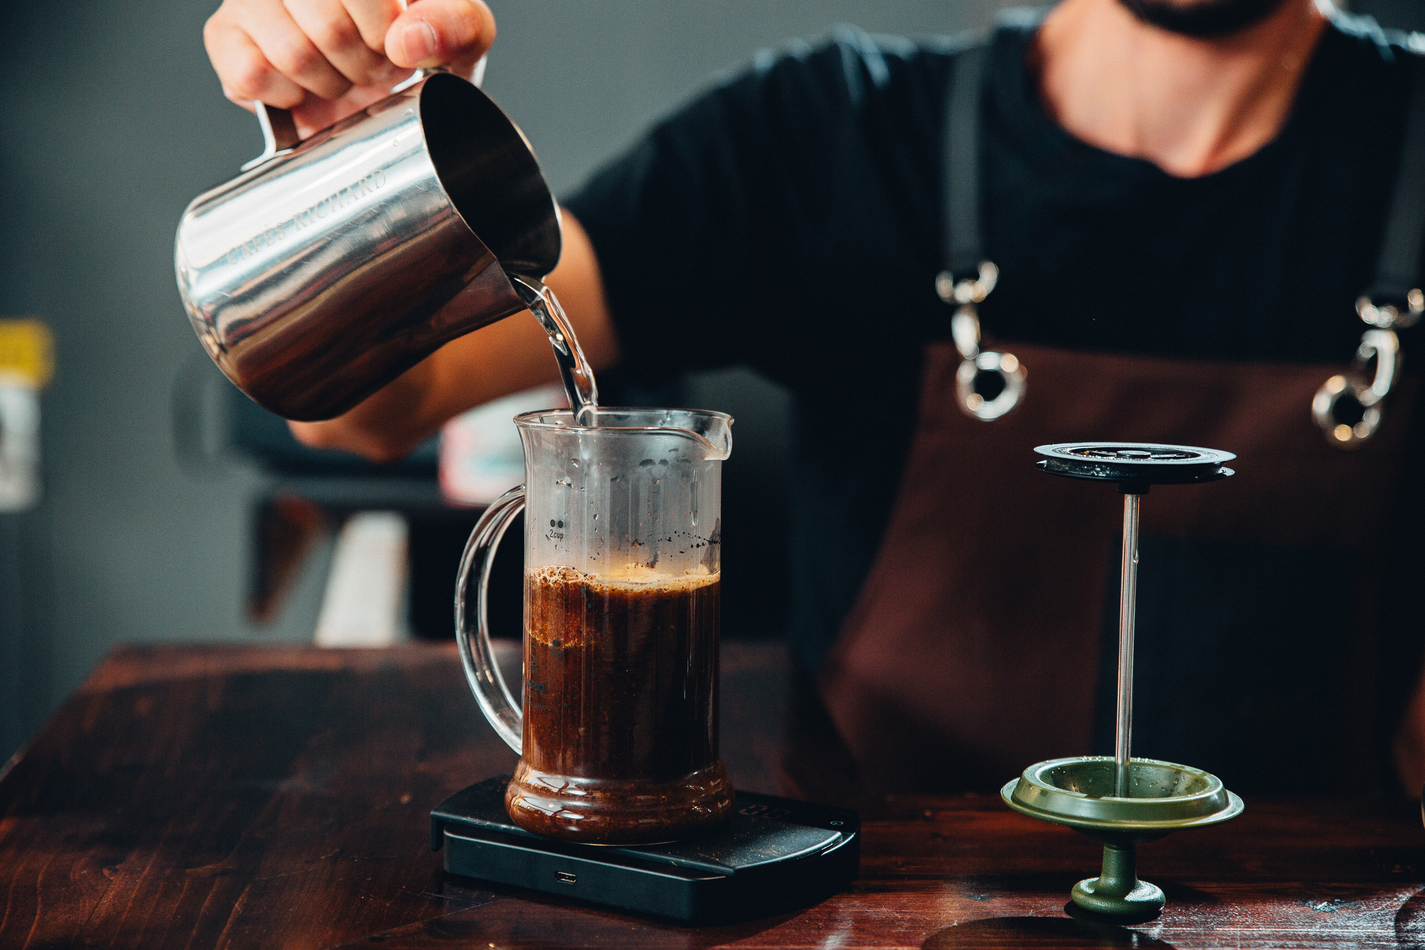
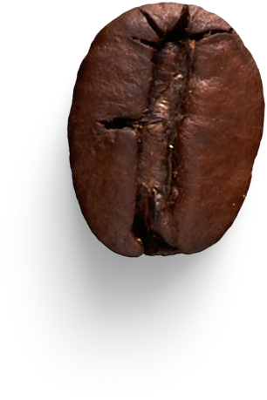
Table of
Content
Introduction
Data Flow Diagram
System Requirements
Execution
Objective
Conclusion

Slide 3

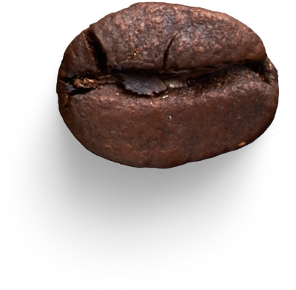

Introduction
Simplify and streamline cafe operations.
Automate order management and order tracking.
Enhance efficiency and the cafe experience.

Slide 4
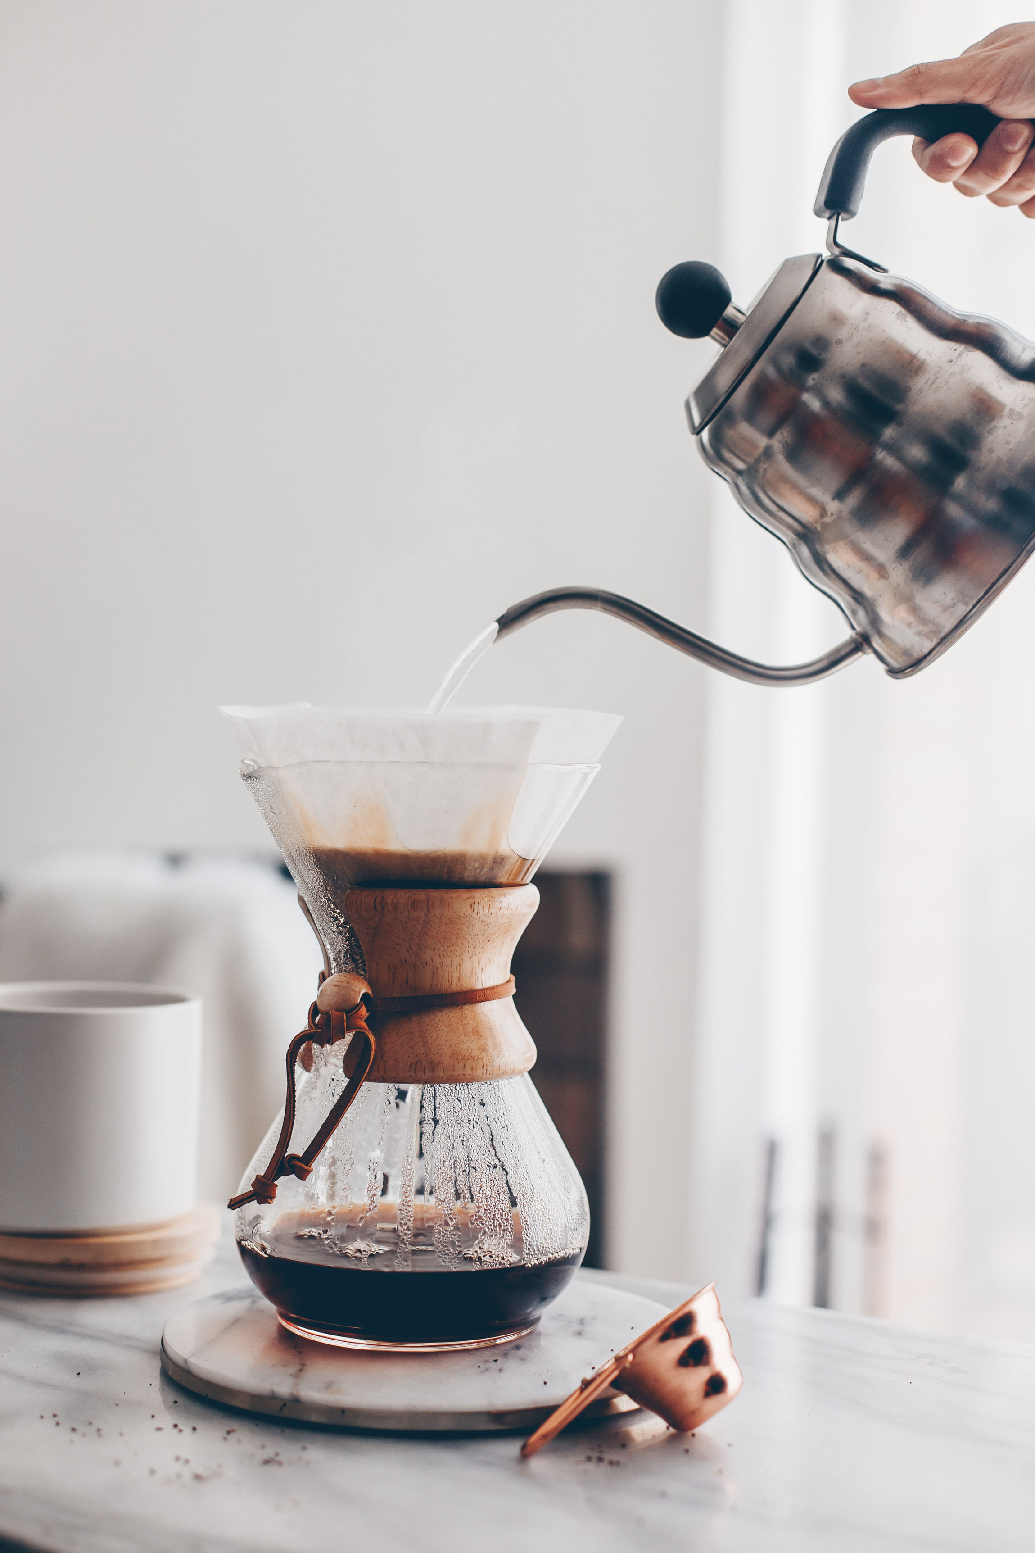





System
Requirements
Hardware requirements
Software requirements
Technology stack
Computer with sufficient processing power and memory
Operating system: Windows, macOS, or Linux
Python 3.x installed
Required Python libraries: Tkinter, PIL, sqlite3
SQLite database
Tkinter module for professional GUI development

Slide 5



Streamline cafe
operations
1.
2.
Improve efficiency
Objective
Enhance customer
experience
3.
Optimize inventory management
4.
Generate valuable
insights
5.

Slide 6





Data Flow Diagram
Place order
Food Order
Bill
Receipt
Management Report

Slide 7
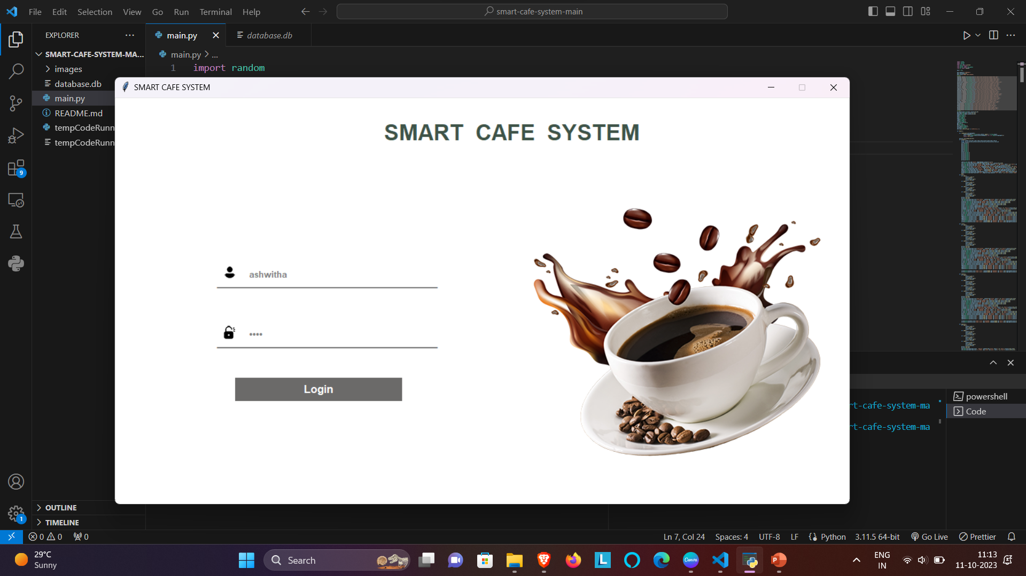
Execution

Slide 8
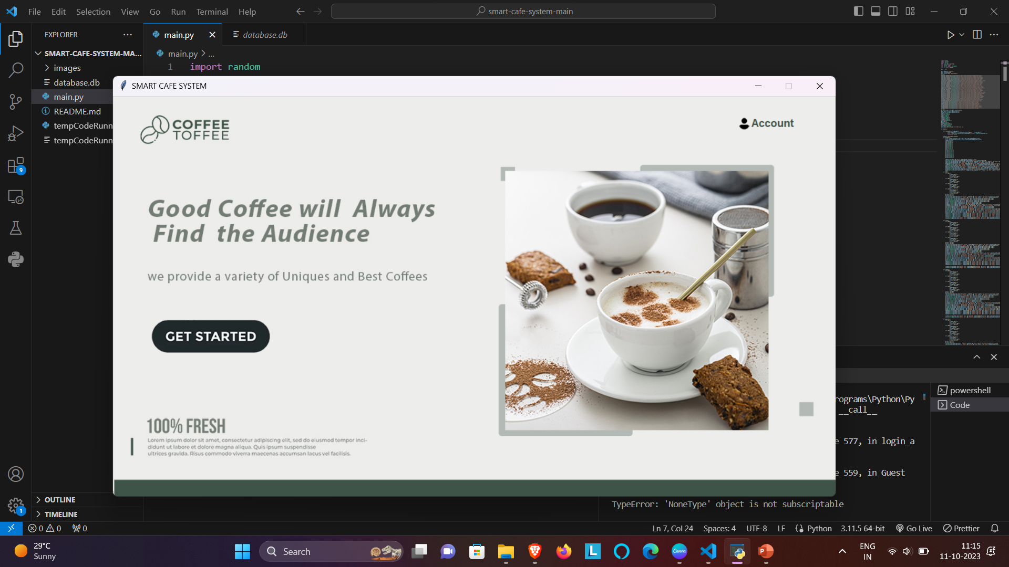

Slide 9
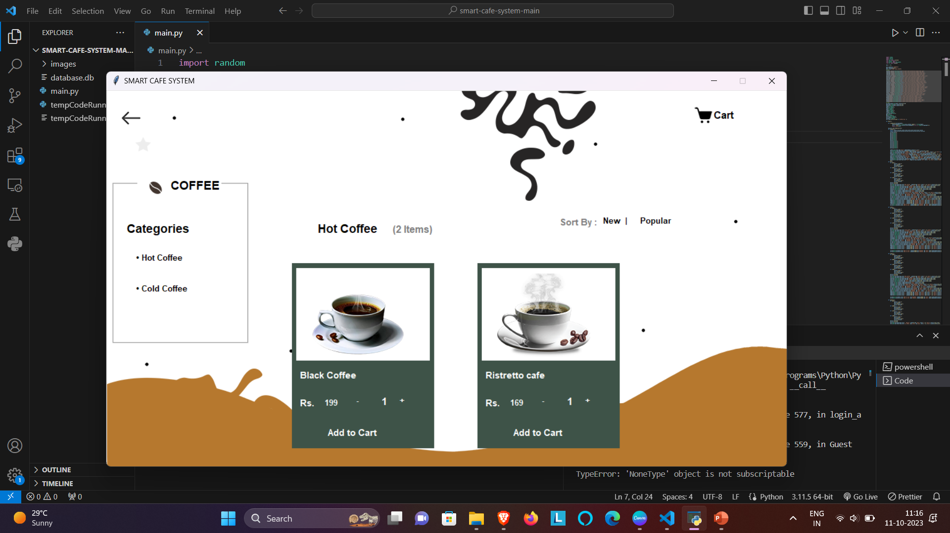

Slide 10


Slide 11


Slide 12


Slide 13
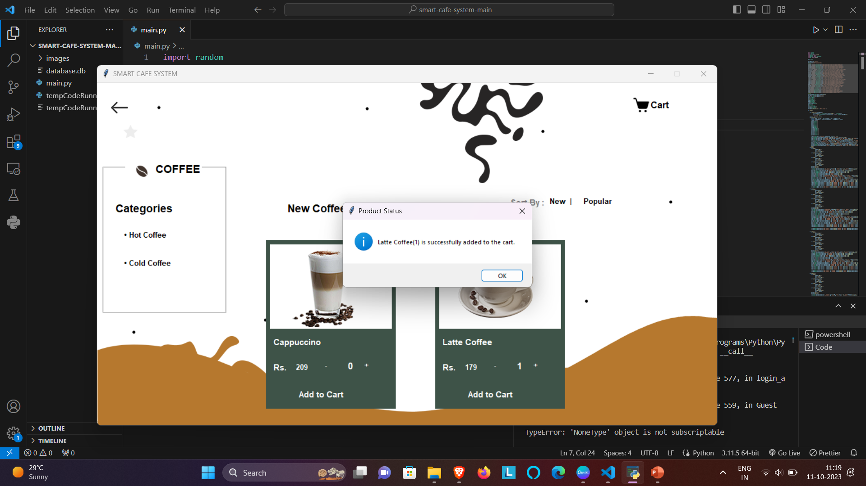

Slide 14


Slide 15
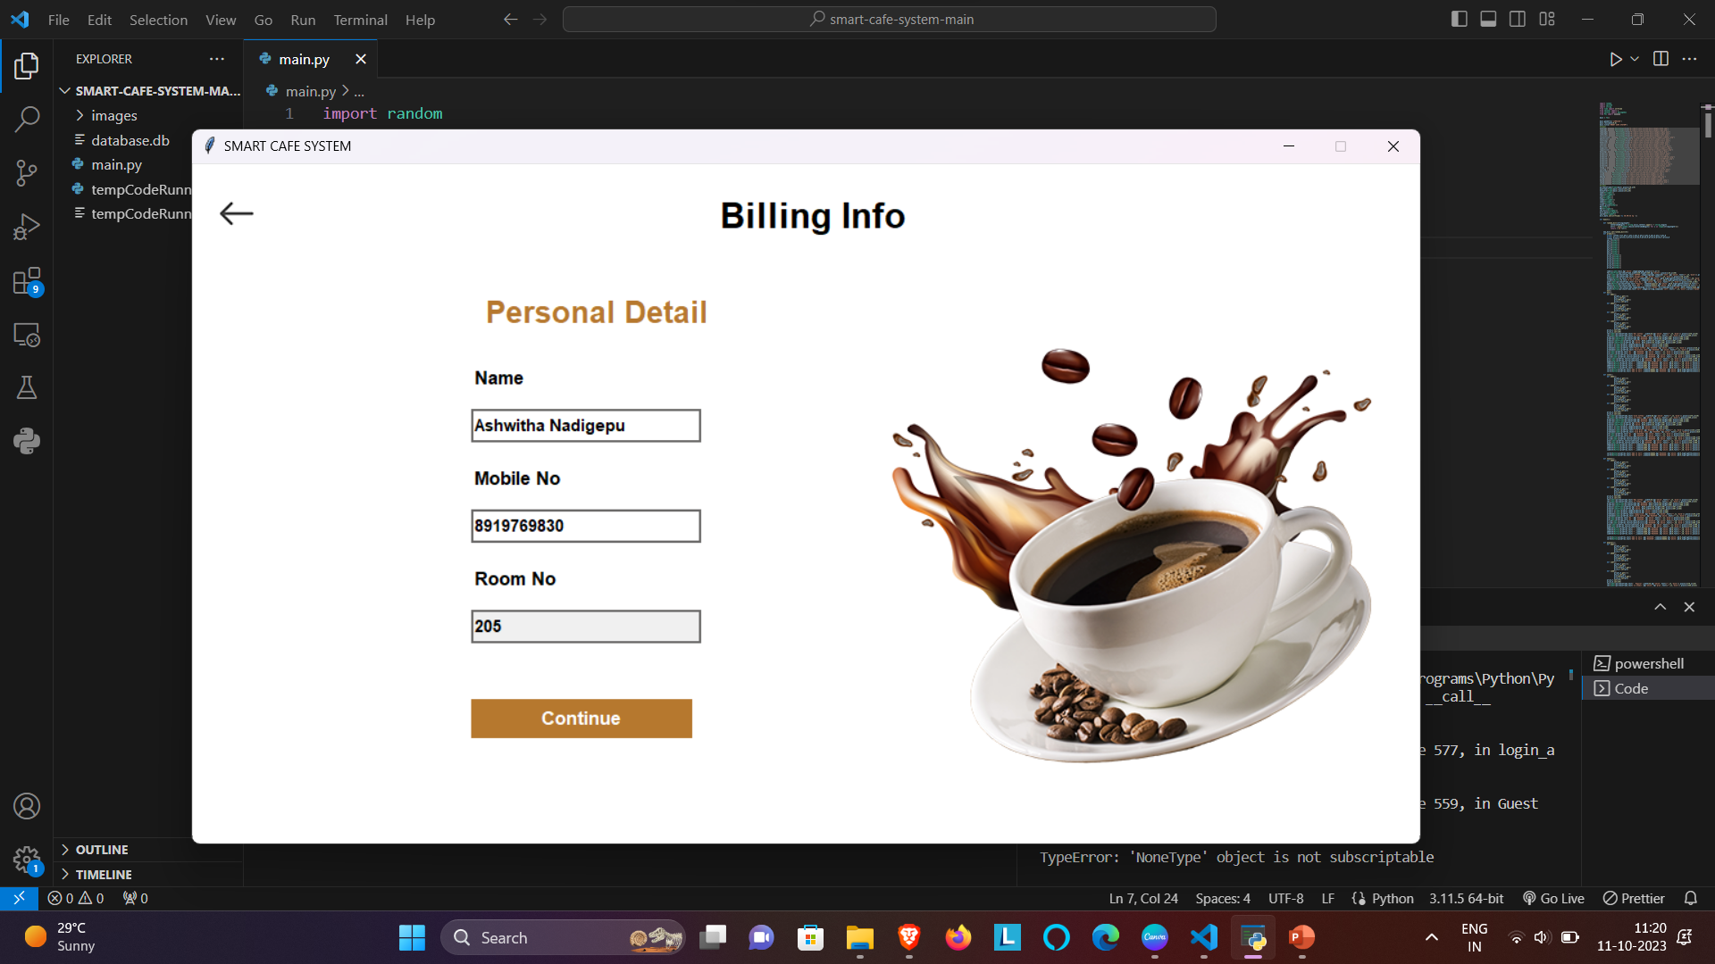

Slide 16
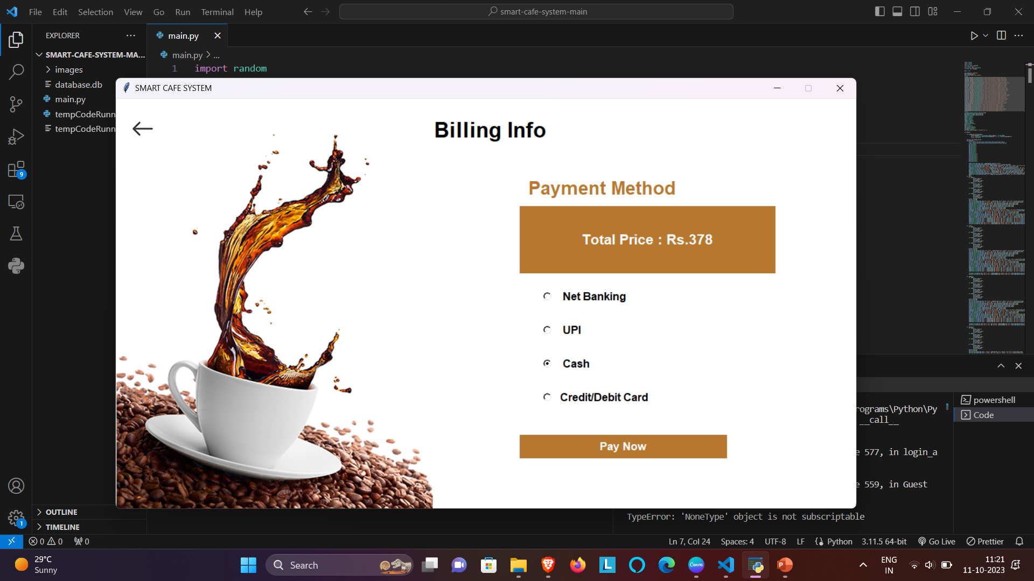

Slide 17
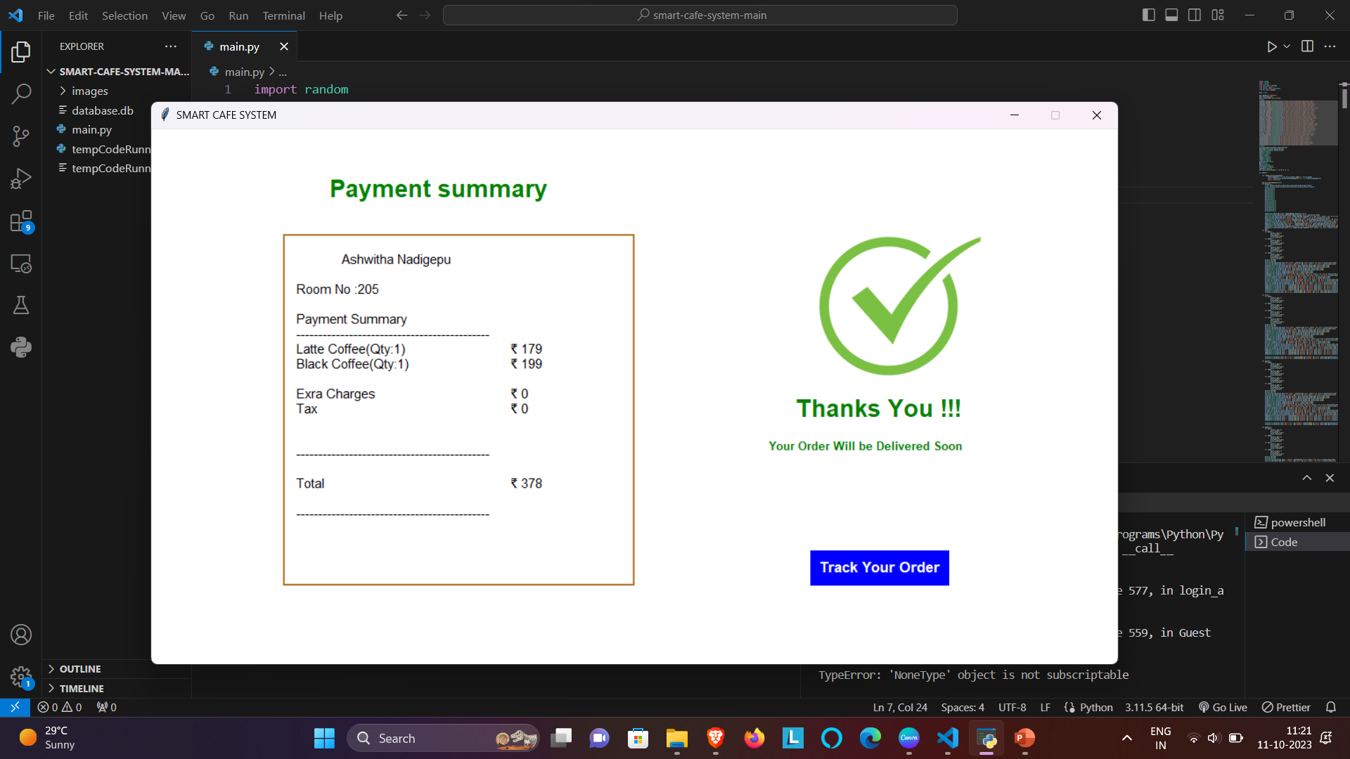

Slide 18
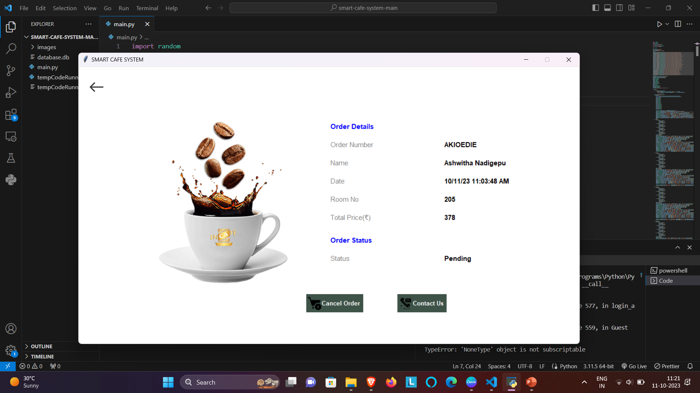

Slide 19
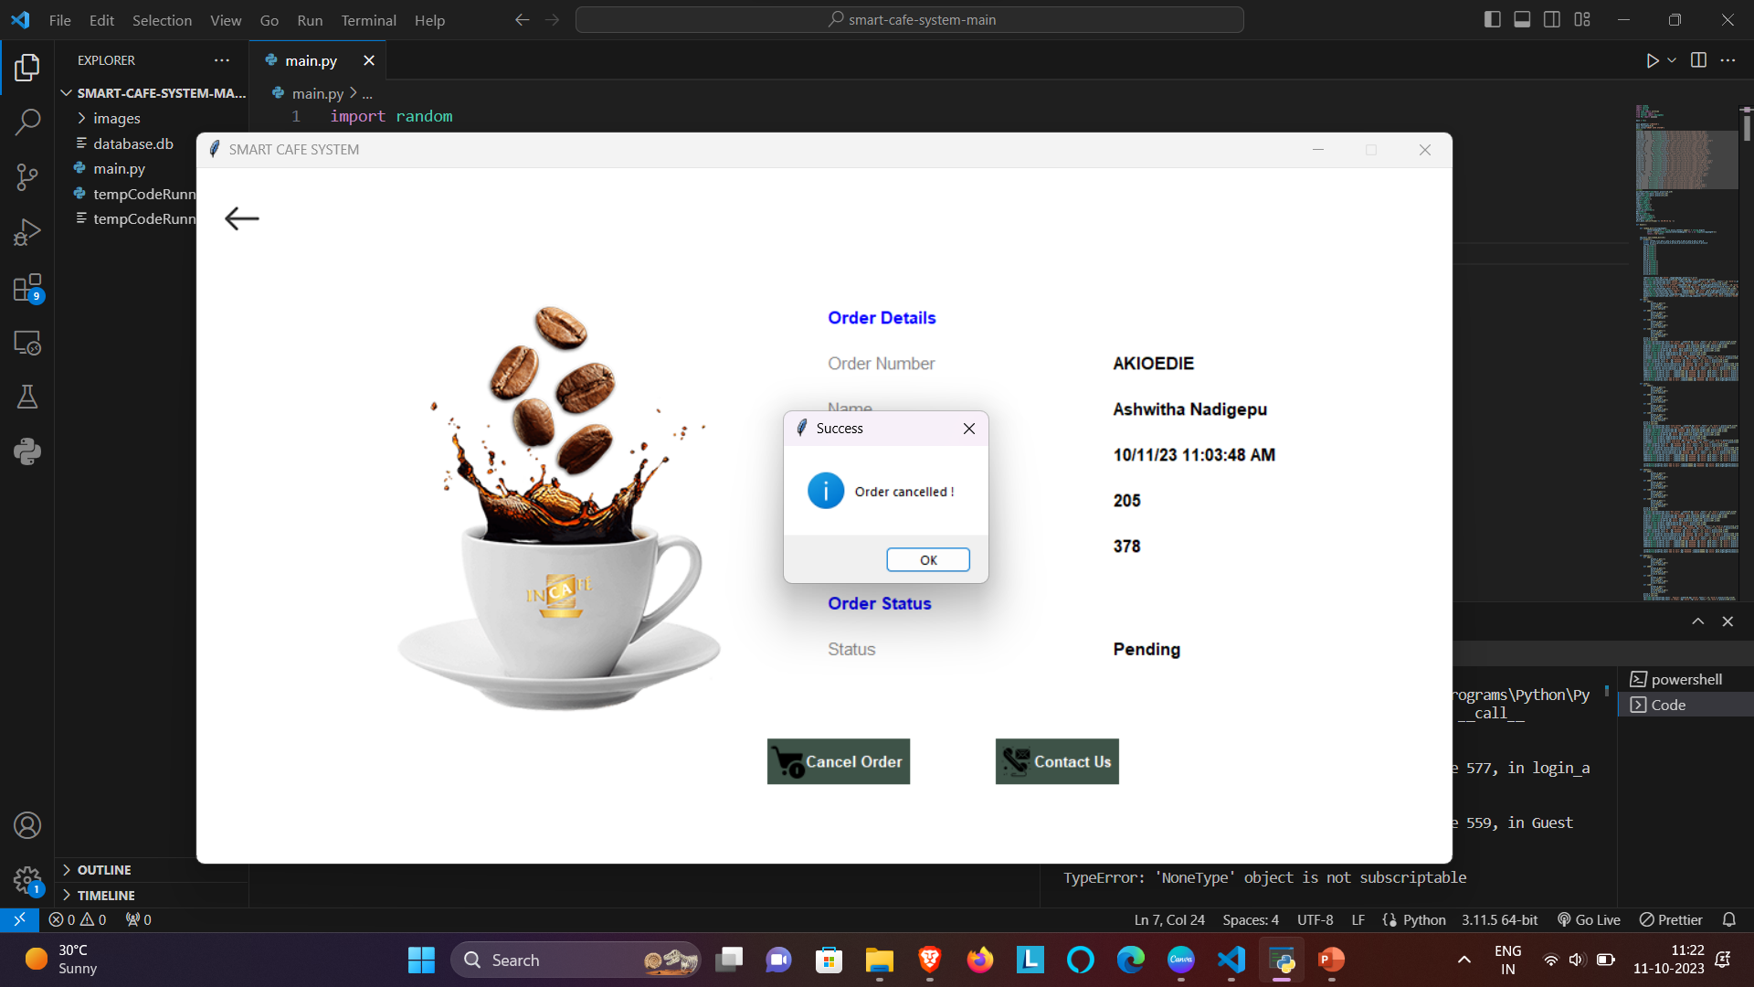

Slide 20
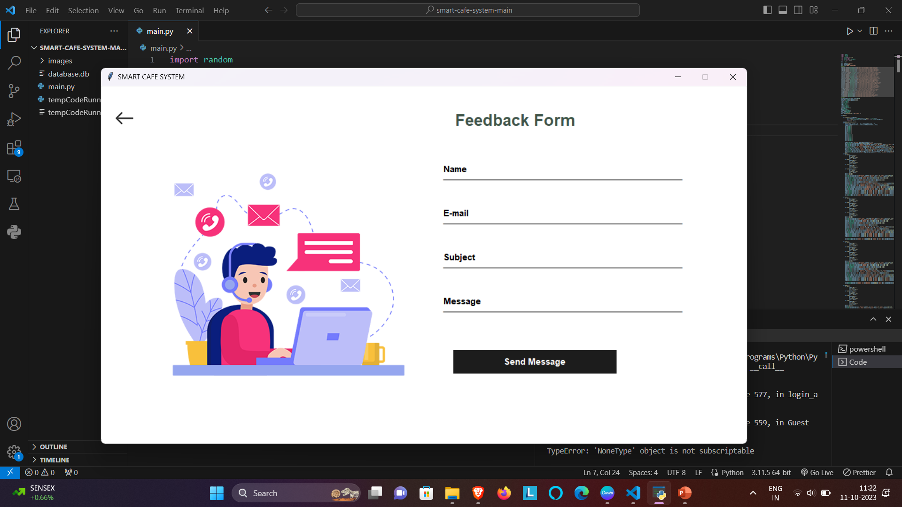

Slide 21
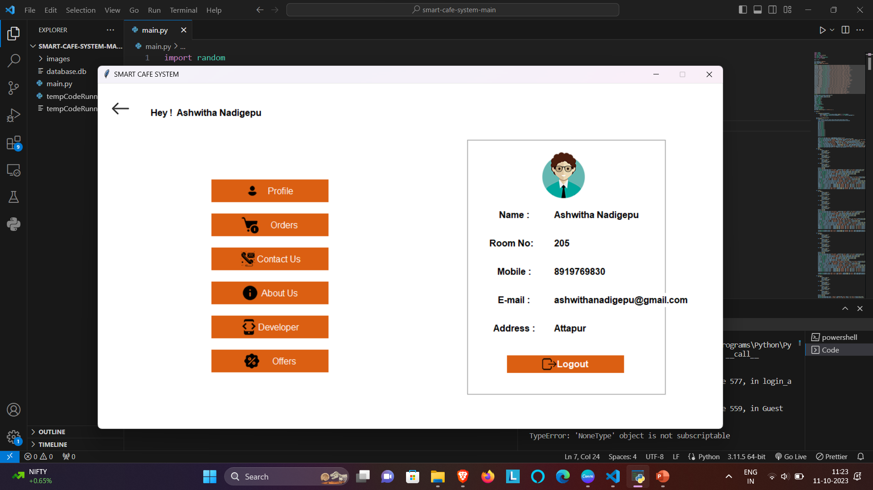

Slide 22
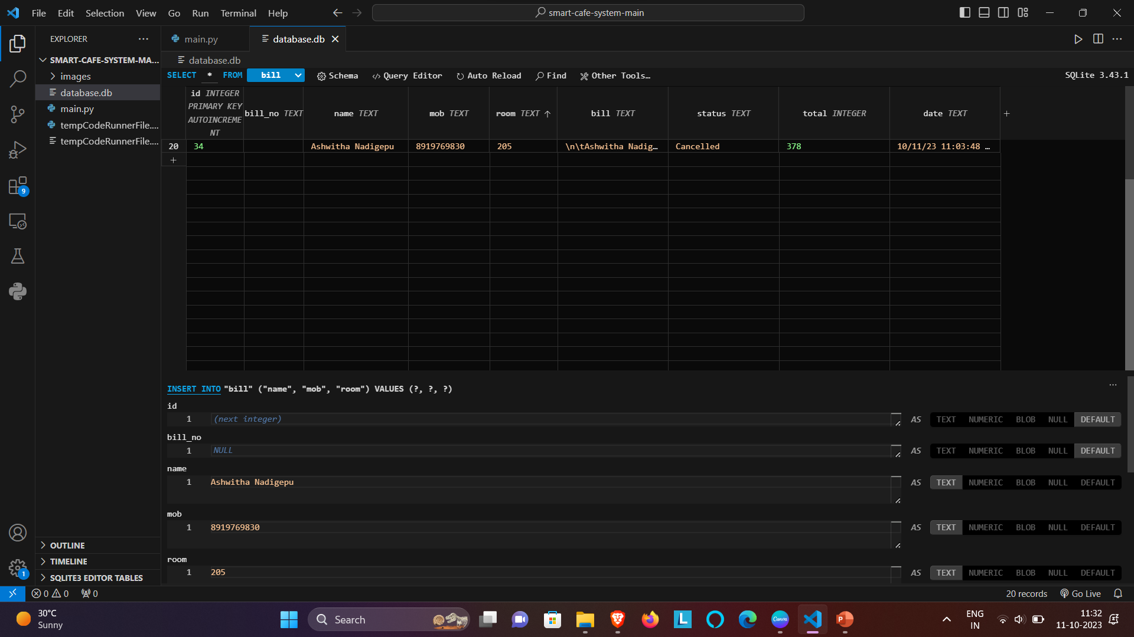

Slide 23
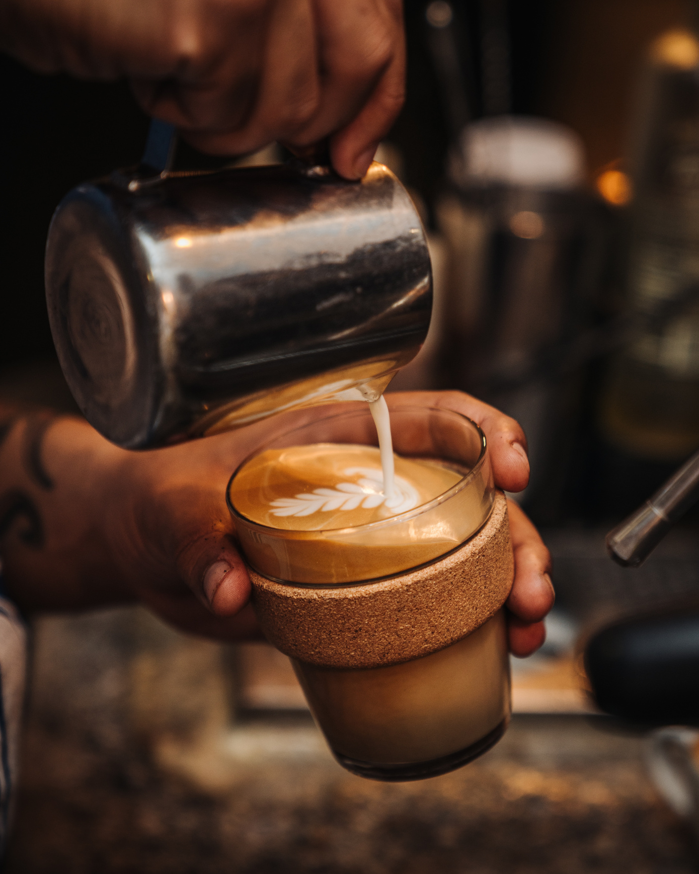


Conclusion
User-Friendly Interface
Customers can easily log in, order coffee, and settle bills.
Efficient Order Management
Orders are securely stored in an SQLite 3 database for the cafe owner's records.
Database Integration
SQLite 3 provides scalability and reliability.
Skills Gained
Valuable experience in Python, GUI design, and database management.
Future Enhancements
Potential for additional features, improved UI, and advanced reporting.
https://github.com/Ashwitha-Nadigepu/smart-cafe-management.git

